Slide 1
Electronic Instrumentation Section-1, Ppt-10

Slide 2
Spectrum Analyzers

Slide 3
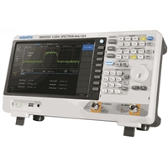
Spectrum Analyzers
A spectrum analyzer measures the magnitude of an input signal versus frequency within the full frequency range of the instrument.

Slide 4
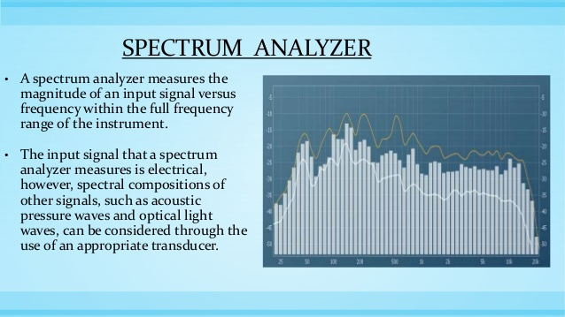

Slide 5
Introduction
By analyzing the spectra of electrical signals dominant frequency, power, distortion, harmonics, bandwidth, and other spectral components of a signal can be observed that are not easily detectable in time domain waveforms.
These parameters are useful in the designing and characterization of electronic devices, such as wireless transmitters.
The display of a spectrum analyzer has frequency on the horizontal axis and the amplitude displayed on the vertical axis.

Slide 6
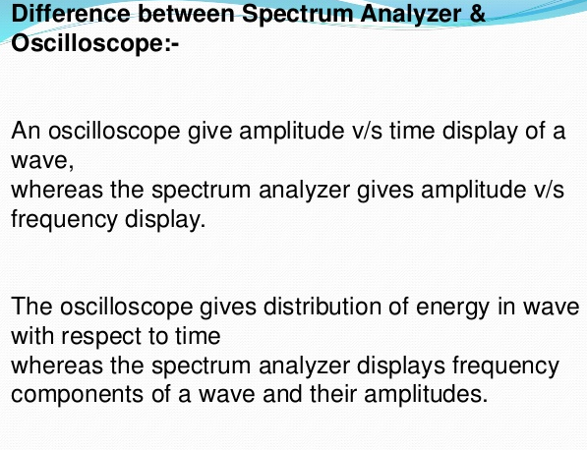

Slide 7
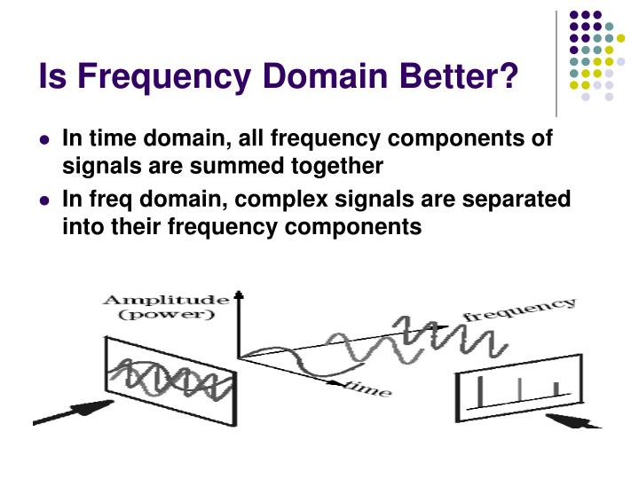

Slide 8
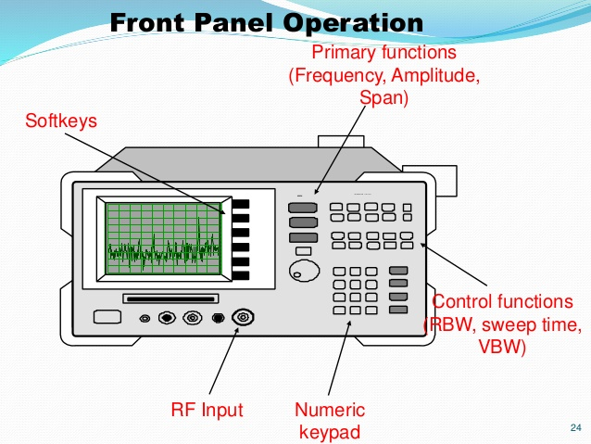

Slide 9
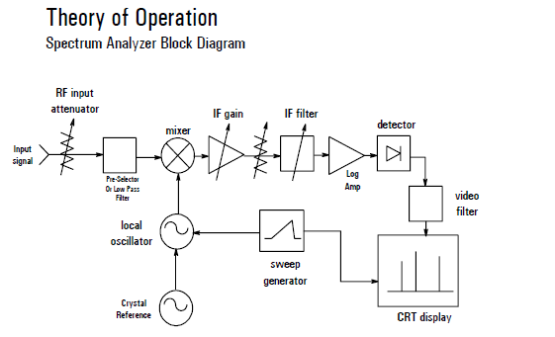

Slide 10
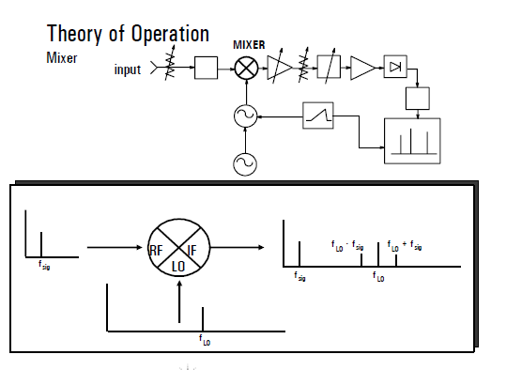

Slide 11
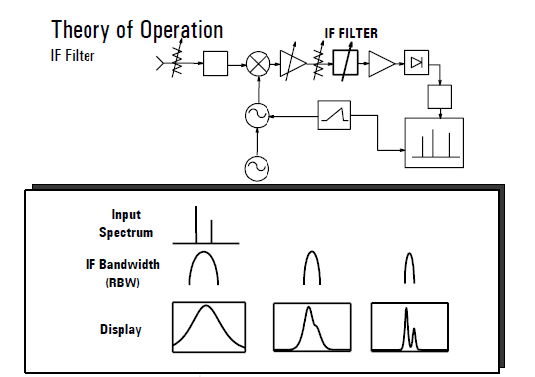

Slide 12
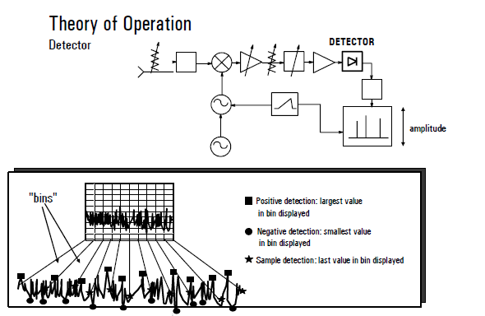

Slide 13
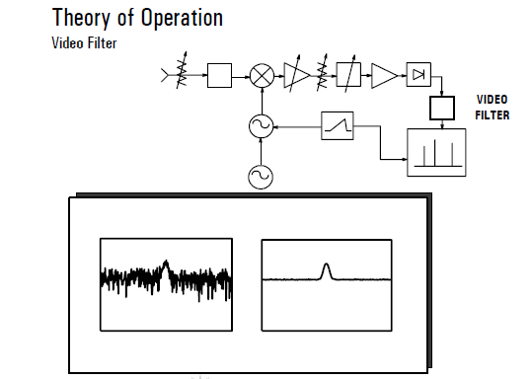

Slide 14
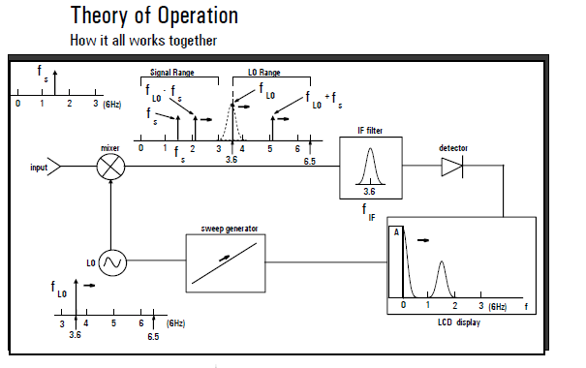

Slide 15
Advantages:
1.it provides better resolution,
2.it provides better frequency coverage.
Limitation
:1.it is more complex than other types of analyzers

Slide 16
Application
The manufacture and maintenance of microwave communications links, radar, telecommunications equipment,
ii.cable TV systems, and broadcast equipment;
iii.mobile communication systems;
iv.EMI diagnostic testing;
v.component testing; and
vi.Signal surveillance.

Slide 17
A band limited signal with a maximum frequency of 5 KHz to be sampled. According to the sampling theorem, the sampling frequency which is not valid is: a) 5 KHz b) 12 KHz c) 15 KHz d) 20 KHz

Slide 18
Spectrum analyzer is
A. a real-time analyzer
B. a non-real time analyzer
C. the same as a wave analyzer in all aspects
D. an instrument not dependent on frequency

Slide 19
Indications of spectrum analyzer is presented by means of
A. a moving meter
B. an iron vane
C. a CRT
D. a LED

Slide 20
An instrument that is capable of displaying waveforms by means of fluorescence in a CRT.
A. oscilloscope
B. wave analyzer
C. spectrum analyzer
D. distortion analyzer

